Slide 1
File Handling
Md. Muktar Hossain

Slide 2
File Handling
Create, Open, Read, and Write to files by declaring a pointer of type FILE, and use the fopen() function.
FILE *fptr;
fptr = fopen(filename, mode);
Parameter Description
filename The name of the actual file you want to open (or create), like filename.txt
mode A single character, which represents what you want to do with the file (read, write or append):
w - Writes to a file
a - Appends new data to a file
r - Reads from a file

Slide 3
Create a File
To create a file, you can use the w mode inside the fopen() function.
The w mode is used to write to a file. However, if the file does not exist, it will create one for you.
FILE *fptr;
// Create a file
fptr = fopen("filename.txt", "w");
// Close the file
fclose(fptr);

Slide 4
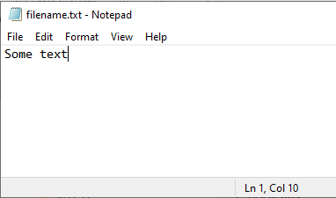
Write To a File
FILE *fptr;
// Open a file in writing mode
fptr = fopen("filename.txt", "w");
// Write some text to the file
fprintf(fptr, "Some text");
// Close the file
fclose(fptr);

Slide 5
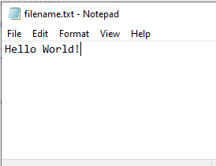
Write To a File
FILE *fptr;
// Open a file in writing mode
fptr = fopen("filename.txt", "w");
// Write some text to the file
fprintf(fptr, "Hello World!");
// Close the file
fclose(fptr);

Slide 6
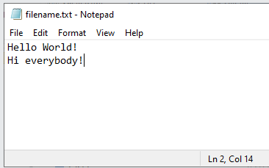
Append Content To a File
FILE *fptr;
// Open a file in append mode
fptr = fopen("filename.txt", "a");
// Append some text to the file
fprintf(fptr, "\nHi everybody!");
// Close the file
fclose(fptr);

Slide 7

Read a File
Need to create a string that should be big enough to store the content of the file.
FILE *fptr;
// Open a file in read mode
fptr = fopen("filename.txt", "r");
// Store the content of the file
char myString[100];
// Read the content and store it inside myString
fgets(myString, 100, fptr);
// Print the file content
printf("%s", myString);
// Close the file
fclose(fptr);
where to store the file content
maximum size of data to read
a file pointer that is used to read the file

Slide 8
References
https://www.w3schools.com/c/c_files.php

